Slide 1
Enter presentation mode
Go to next slide

Slide 2
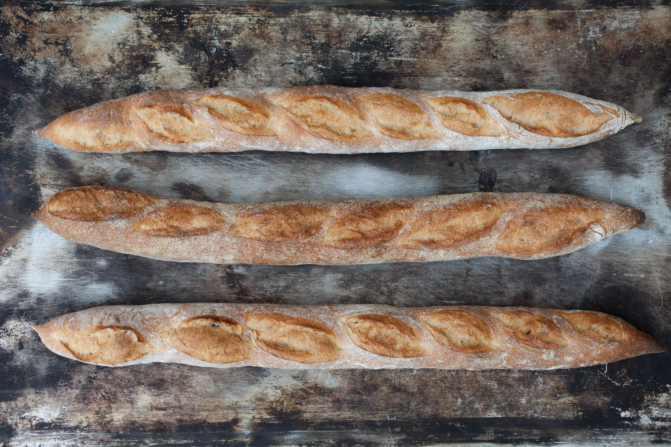
Go to next slide

Slide 3

Go to next slide

Slide 4
Go to previous slide
If you already been here just go to next slide

Slide 5

1. Play video 2. Stop video when it starts raining fruit

Slide 6
1. Enter question block 2. To exit question block repeat same command 3. Go to next slide

Slide 7
Exit presentation mode

